Slide 1
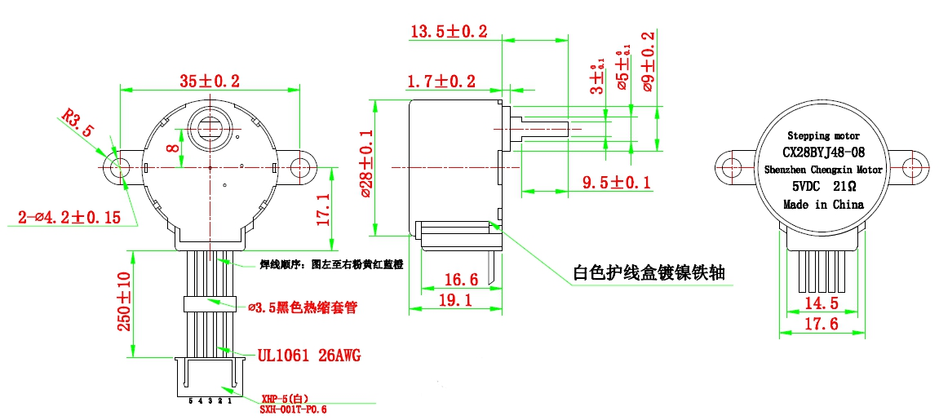
connection sequence
(from left to right)
Pink/yellow/red/blue/orange
White protective wire box
ø3.5 Black heat
shrinkable sleeve

